Slide 1
CCH® Tagetik Smart NOW Workforce Planning

Slide 2
Agenda
Challenges
CCH® Tagetik Workforce Planning
Benefits
Key Features
Customer Success Stories
Additional Configuration

Slide 3
Challenges for Finance
Accurately Projecting Workforce Data
Changing Requirements
Security
Containing Costs & Saving Time
Payroll expenses represent a significant portion of the profit and loss.
It’s very difficult to project workforce costs accurately because there are so many changing assumptions.
Life happens. People move on. Budgets change. Business models shift.
The parameters of a workforce are constantly in flux. Again: assumptions are constantly changing.
Employee data is sensitive. Often, only the HR department or each entity owner is allowed to see employee data.
Workforce planning needs a secure environment.
As always, Finance is looking to contain costs and reduce inefficiencies in processes to streamline operations and reduce costs.

Slide 4
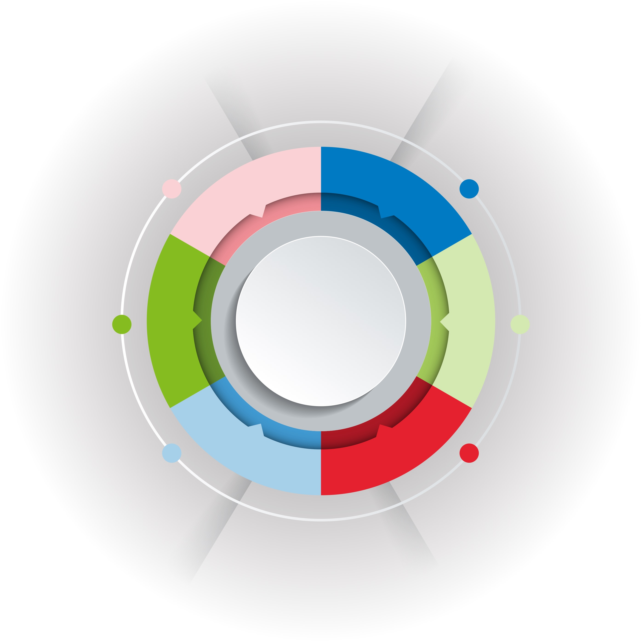
Empowering CFOs and their peers to propel their strategy with faster and better-informed decisions
BI & REPORTING
Financial close
& consolidation
Financial
planning
Regulatory
compliance
CCH® Tagetik
Integrated
business planning
Corporate tax
Supply chain
planning
Strategic & financial intelligence platform
Data
integration
Open
& extendable
Cloud &
On-premise
Financial & operational insights
AI-based predictive intelligence
Configurable
Workflows
Connectivity
Notes:
@Anthony

Slide 5
The CCH® Tagetik platform underpinned by the Analytic Information Hub enables our XP&A vision
Platform for all processes
Connect multiple systems and processes via data integration
Advanced reporting
Combine native reporting with data from all processes and MS Office
Quickly build and deploy new business solutions
Dept-specific, industry-specific or regulatory
Powerful Data Transformation
Integrate, collect, normalize and transform data
Empower solutions
Add granular data for more robust solutions and greater insights
Business-owned
Low code/no code configuration, reducing IT dependency
CCH® Tagetik Analytic Information Hub
Open Data Model with unlimited dimensionality
Host operational details at a very granular level
Addresses local requirements without impacting overall governance – controlled flexibility
Optimized for fast performance
Foundation to leverage advanced technologies (AI, ML, etc.)
Notes:
@Anthony

Slide 6
Going beyond traditional FP&A to unified planning
Impacting the whole enterprise with extended solutions
Integrated Business Planning
Optimize operational efficiencies
Budgeting, Planning & Forecasting
Cash Flow Planning
Capital Expenses Planning
Production Cost Planning & Control
Workforce Planning
Supply Chain Planning
Business
Planning n…
AI-based, predictive intelligence provides faster and better-informed decisions
Notes:
@Anthony

Slide 7
Planning across the organization
Comprehensive solution set and flexible solution
Integrated Business Planning
Optimize operational efficiencies
Budgeting, Planning & Forecasting
Cash Flow Planning
Capital Expenses Planning
Production Cost Planning & Control
Workforce Planning
Supply Chain Planning
Business
Planning n…
Strategic Plan / LRP
Revenue Planning
Balance Sheet Planning
Cash Flow Planning
CAPEX / OPEX
Production Cost Planning
Workforce Planning
HR Planning
Sales Planning
Demand Planning
Supply Planning / MEIO
Production Planning
S&OP
IT Planning
Marketing Planning
Business Planning n….
Notes:
@Anthony

Slide 8






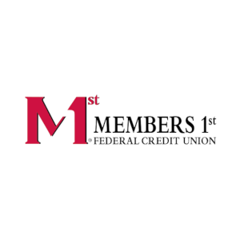

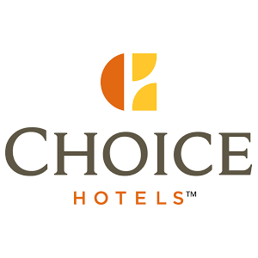



CCH Tagetik Smart NOW Workforce Planning
Optimize Your Human Capital By Putting Your Workforce Data to … Work
Assess business impact and optimize your workforce needs
Optimize your human capital and manage workforce needs. Quickly plan compensation, determine employee costs, and track employee movements throughout the organization. See how workforce decisions can impact operations, finance, cost centers, and profitability, with all your departments aligned in a single solution.
Use CCH Tagetik to model and play out what-ifs to view how changes to headcount, salaries, benefits, incentives, impact your HR plans and fully-burdened labor costs.
Quickly plan compensation, determine employee costs, and track employee movements throughout the organization
Pre-configured using best practices to ensure a consistent standardized approach
Calculation rules, data validation and reporting tools you need to make workforce decisions – fast.
Align finance, operations and HR with detail-level insights
Twinfield Accounting (Netherlands)
Notes:
@Leslie

Slide 9
CCH® Tagetik Smart NOW Workforce Planning
Optimize Your Human Capital By Putting Your Workforce Data to … Work.
3 reasons why CCH Tagetik Workforce Planning let’s you focus on your business:
Fast and accurate planning
Project compensation precisely. Leverage our powerful data engine to plan salary and benefits at the employee and department level, future develop compensational models and adjust to changing human variables.
Pre-defined report templates
This pre-configured solution comes complete with a suite of standard reports specific to workforce planning needs. With the click of a button, they automatically refresh with your latest results.
Implement best practices
Save time with pre-built logic using consistent standards developed from over 10 years of implementing workforce solutions for our customers.

Slide 10
Key Benefits
Implement
quickly
Fast & accurate planning
Pre-defined reporting templates
Existing employees & new hires
Expert solution is pre-built for fast implementation and fast time-to-value
Specifically built for workforce needs
Project payroll expenses quickly and precisely
Plan wages, project payroll expenses, determine employee costs, develop compensational models
Easily adjust to changing human variables
Solution provides a suite of standard reports specific to workflow planning needs
Automatically refresh workforce plans with your employee data
Employee and global level
Promotions, terminations, new hires, salary models, benefits, or taxes
Day-to-day needs, plan for the future and respond to the unexpected with the full picture of impacts

Slide 11
Key Benefits
Flexibility & control
Integrated planning
Implement
best practices
Cloud solution
Out-of-the-box calculation logic, data validation, reporting tools and workflow that are easy to extend to meet your needs
Owned and maintained by Finance
Unified solution for all your planning needs (strategic, financial, operational) that automatically validates projected data
Best practice methodology for workforce planning
Created from over 10 years' experience implementing workforce solutions for customers
Quick and easy setup with no hardware and reduced IT needs
99.5% uptime guaranteed and 24-7 monitoring
Best in class security certifications

Slide 12
Key Functionality
Wage and Salary Planning
Agile Time Horizons
Payment Plans
Merit and Bonus LogiC
Compensation Items
Employee FTE Management
Reporting
P&L Integration
What-if Scenarios
Finance Transformation Platform

Slide 13

Customer Success

Slide 14



Choice Hotels gain 50% faster cycles and increased stakeholder confidence
CCH® Tagetik processes: Budgeting and Planning, Workforce Planning App, on Cloud
CHALLENGES
DIFFERENTIATORS
ACHIEVEMENTS
Inefficient process that’s too time consuming and error-prone with Excel spreadsheets
Desire to lessen time collecting data and shift to an automated process with time for in-depth analysis and insight
Centralized and manual process with only a few resources able to access and use
Lots of data quality challenges and lack of visibility to data and insights
Annual budgeting and forecasting cycles, including financial and non-financial data and metrics
Rolling forecast with flexibility to choose how many years to include
Decentralized collection with users across the business units, beyond finance, are now able to access the system
Pre-packaged starter kick for Workforce planning for detailed payroll planning with data from Workday
Employee-based payroll planning at the FTE level for salary, bonus, long term incentive compensation
50% Faster cycles with streamlined budget, planning and forecast processes
Increased access to business users and visibility to data across the organization
Flexible solution able to accommodate individual business unit requirements
Fast implementation and standardized process with pre-packaged starter kit
Increased stakeholder confidence with improved reporting including key KPI’s, intuitive dashboards
Notes:
@Anthony

Slide 15

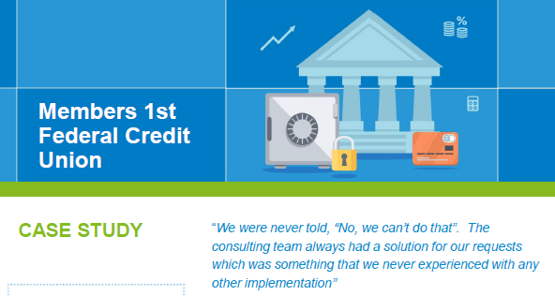
Members 1st gains confidence with visibility to details and more frequent forecasting
CCH® Tagetik processes: Budgeting and Planning, Workforce Planning, Capital Expenses Planning, OPEX, Interest/Non-Interest, Collaborative Office
CHALLENGES
DIFFERENTIATORS
ACHIEVEMENTS
Home-grown solution no longer usable for 55+ US locations, 450K members, 5B assets
Infrequent budgeting & planning – once a year only
On-premise solution, but wanted to move to the cloud
Slow reports, taking 2 to 3 days to rebuild and refresh
No ad-hoc reporting ability
Unified solution for Budgeting and Planning for financial and operational planning
CAPEX/OPEX detailed modules
Workforce HR Planning pre-built module, with configuration flexibility
Native Report builder with self-service and ad-hoc analysis
Banking functionality and experience
Cloud deployment
Increased forecast frequency
Significantly faster month-end cycles and variance analysis
Visibility to details for ‘C’ suite and management, especially important during COVID
Focus on value-added activities
Detailed HR planning (salary, benefits) at employee level
Flexibility to grow with Members 1st
“The Workforce planning module has allowed us to plan, report, and analyze compensation and benefit items down to the associate level (lowest level), which has drastically reduced our month-end variance research and reporting time.”
Brian Strohecker, Budget & AP Manager, Members 1st
READ CASE STUDY

Slide 16
Thank you

Slide 17



CCH Tagetik Smart NOW Workforce Planning
Optimize Your Human Capital By Putting Your Workforce Data to … Work.
Optimize your human capital and manage workforce needs. Quickly plan compensation, determine employee costs, and track employee movements throughout the organization. See how workforce decisions can impact operations, finance, cost centers, and profitability, with all your departments aligned in a single solution.
Ideal for:
CFO
FP&A Dept
HR Planner
KEY CAPABILITIES
BENEFITS & VALUE
CCH Tagetik aligns detailed employee information with financial and operational data, bringing together employee data sources to one centralized place.
Quickly plan compensation, determine employee costs, and track employee movements throughout the organization.
Pre-configured using best practices to ensure a consistent standardized approach
Calculation rules, data validation and reporting tools you need to make workforce decisions – fast.
Align finance, operations and HR with detail-level insights
Use CCH Tagetik to model and play out what-ifs to view how changes to headcount, salaries, benefits, incentives, impact your HR plans and fully-burdened labor costs.
Plan wages and compensation (benefits, taxes) at the individual employee level
Manage existing roster, employee transfers and define new hires
Define assumptions on merit increase & bonus
Flexible configuration of the compensation items
What-if Scenario Analysis (i.e. Snapshot, assumptions update, plan for terminations etc.)
Standard set of reports
Collaboration Tools, Workflow and Audit trail

Slide 18
CCH Tagetik Smart NOW Workforce Planning
Properly account for the financial impact of headcount, salaries, benefits, incentives and other workforce business drivers to align finance with HR and integrate workforce planning with all financial performance.
KEY CAPABILITIES
BENEFITS & VALUE
Direct integration with HR Source Systems
Salary, Tax & Benefit Planning for existing employees and new hires (job types, insurance plans, etc)
Merit and Bonus Driver based Modeling
Employee Management for transfers, promotions, terminations, backfills, etc
Business and Approval Workflow
FTE and HC Attrition & Capacity Reporting
What-if Scenario planning & modeling
Pre-defined but extensible calculations and templates
Quick Results with contained investment but high ROI
Accurate projections to address key cost company cost components
Align finance and HR for better business decisions
Secure sensitive data
Based on best practices from hundreds of HR Implementations
Fully integrated with the rest of CCH Tagetik offering for Budgeting, Planning & Forecasting

Slide 19
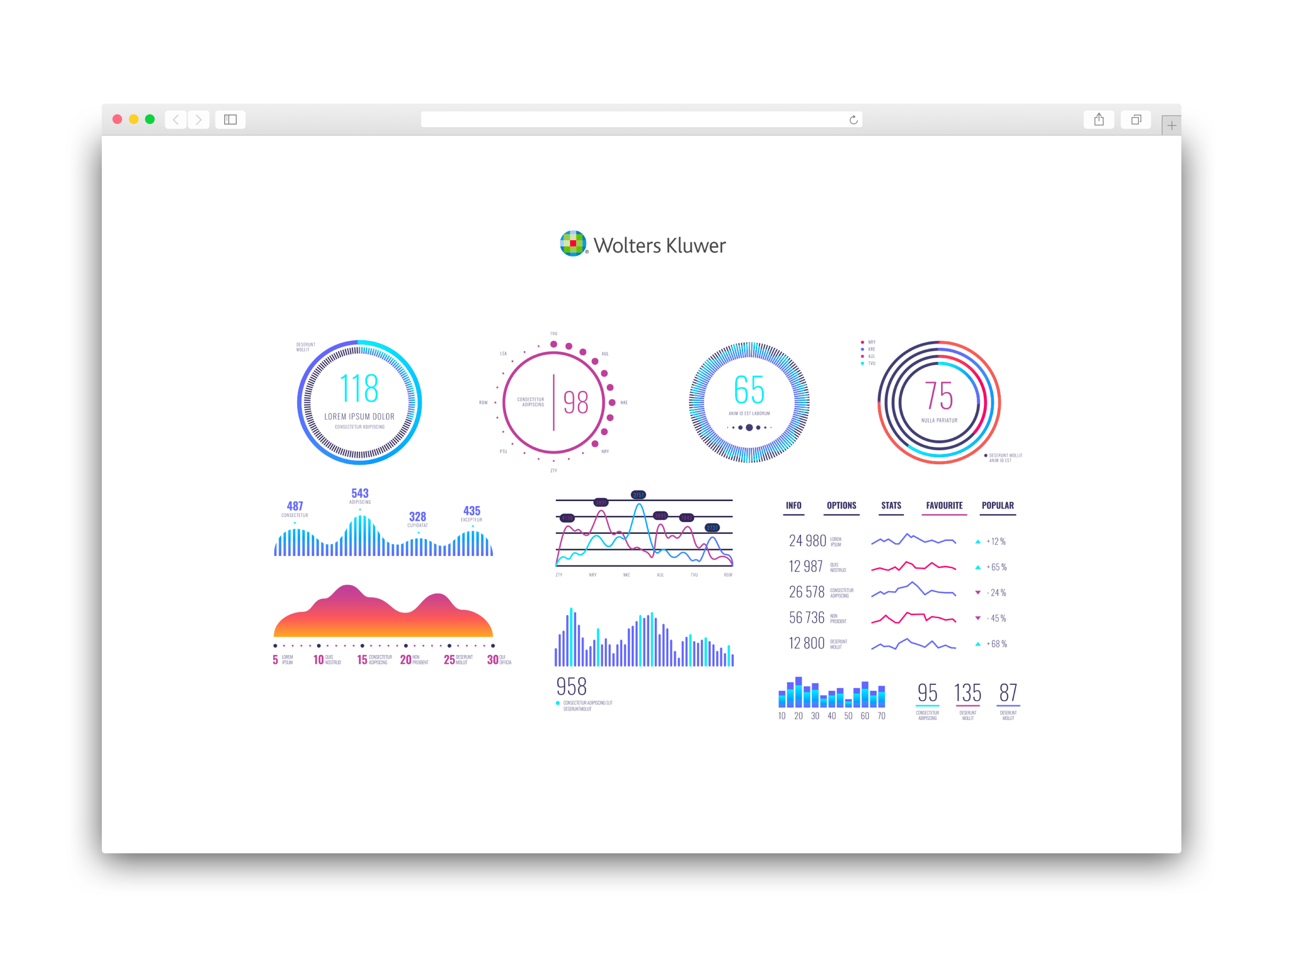
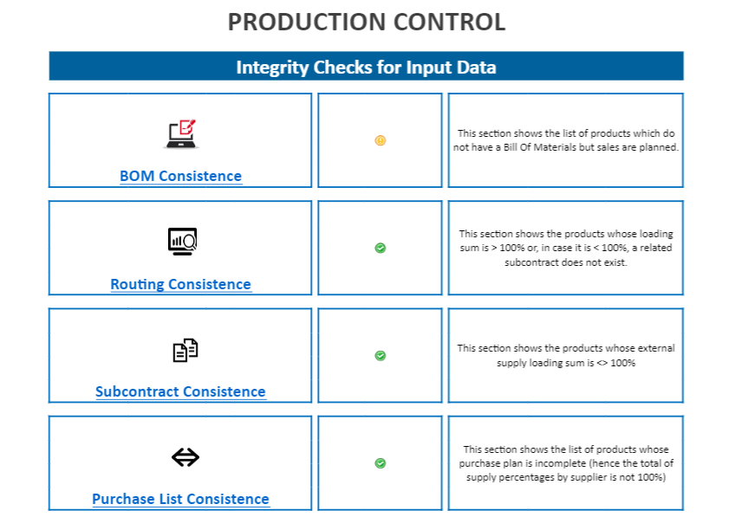
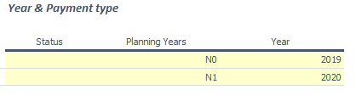
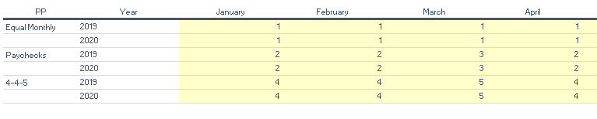
Configuration – Planning years
Admin Configuration: Planning Years
Payment plan

Slide 20
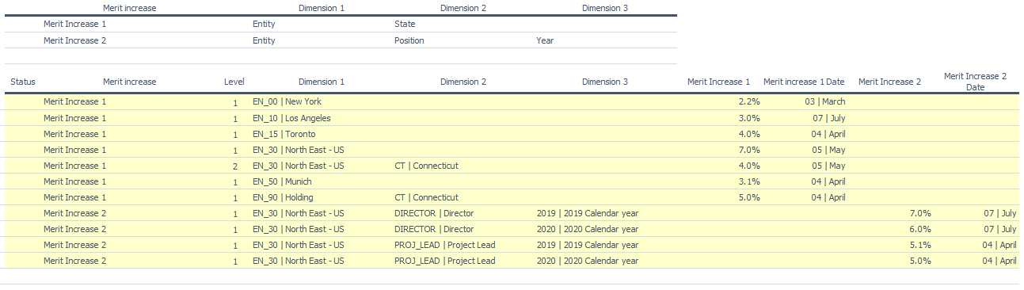
Configuration – Merit Increase & Bonus
Admin Configuration: Merit Increase & Bonus

Slide 21
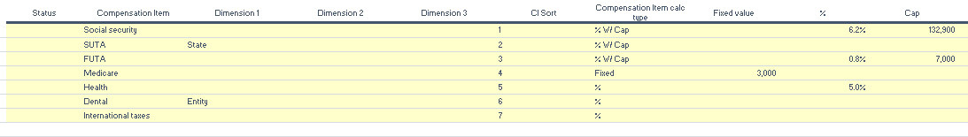
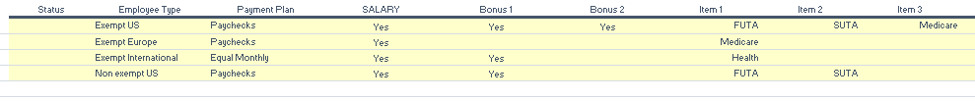
Configuration – Compensation
Admin Configuration: Compensation Items
Employee categories

